Slide 1




Gestione del paziente cardiologico a bordo
delle navi da crociera e traghetto
Prof. Salvatore Di Somma, MD, PhD
Head Emergency Medicine Sant’Andrea Hospital
Director Postgraduate School of Emergency Medicine
Faculty of Medicine and Psycology
Sapienza University of Rome ,Italy

Slide 2
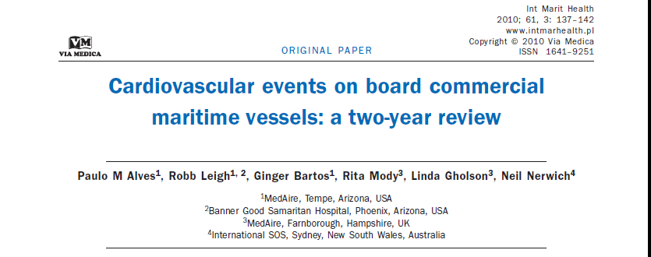


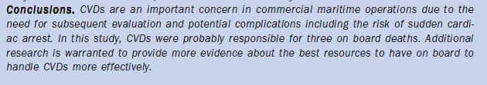

Slide 3
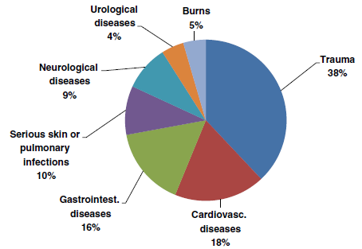
Frequencies (%) of serious medical emergencies in all types of vessels
Oldenburg et al. Nautical officers at sea: emergency experience and need for medical training
Journal of Occupational Medicine and Toxicology 2014, 9:19

Slide 4
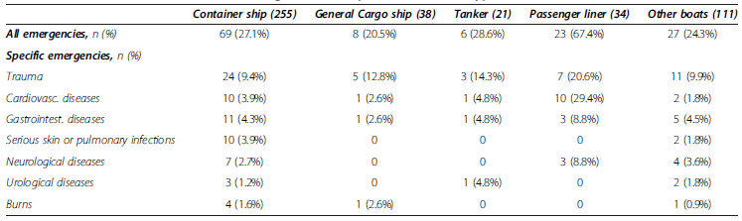
Occurrence of serious medical emergencies in respect of the vessel type
Oldenburg et al. Nautical officers at sea: emergency experience and need for medical training
Journal of Occupational Medicine and Toxicology 2014, 9:19

Slide 5
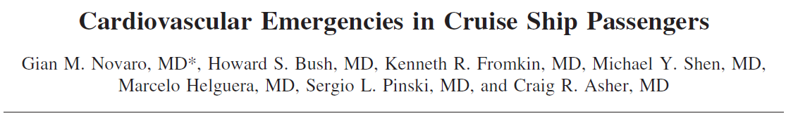


Department of Cardiology, Cleveland Clinic Florida, Weston, Florida, USA.
The aim of this prospective study was to examine the types of CV emergencies in adults on cruise ships and determine the diagnostic and therapeutic procedures required.
Am J Cardiol. 2010 Jan 15;105(2):153-7

Slide 6
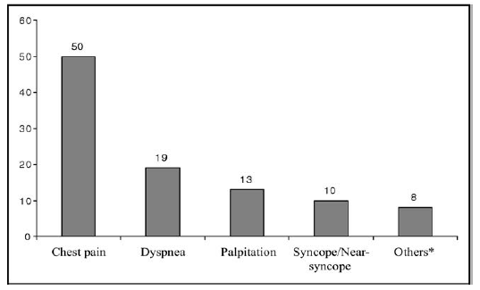
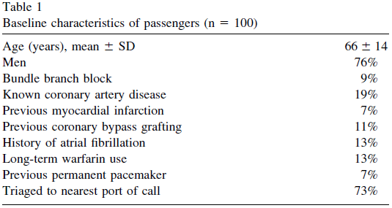
Most common presenting CV symptoms to cruise ship infirmary
Am J Cardiol. 2010 Jan 15;105(2):153-7

Slide 7
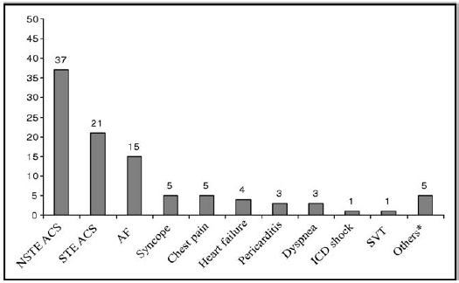
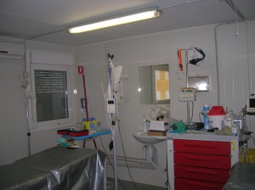
Most common principal CV diagnosis presenting to cruise ship infirmary
Common diagnostic studies performed in the cruise ship’s medical center included 12-lead electrocardiography, continuous telemetry monitoring, chest radiography, oxygen saturation, arterial blood gas, laboratory studies (complete blood count, basic metabolic panel, creatine kinase, cardiac troponin, myoglobin, prothrombin time).
Am J Cardiol. 2010 Jan 15;105(2):153-7

Slide 8
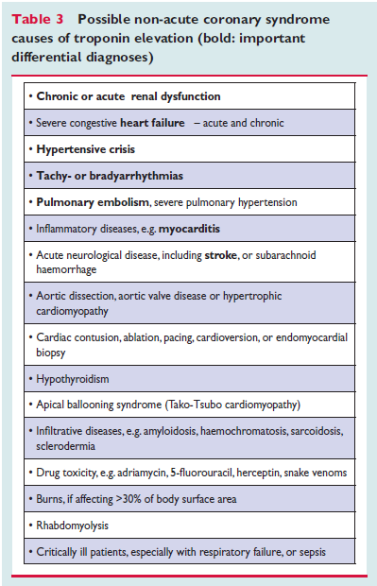
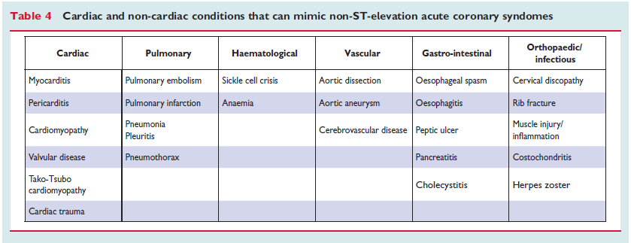

Chest Pain Differential diagnoses
Several cardiac and non-cardiac conditions may mimic NSTE-ACS

Slide 9
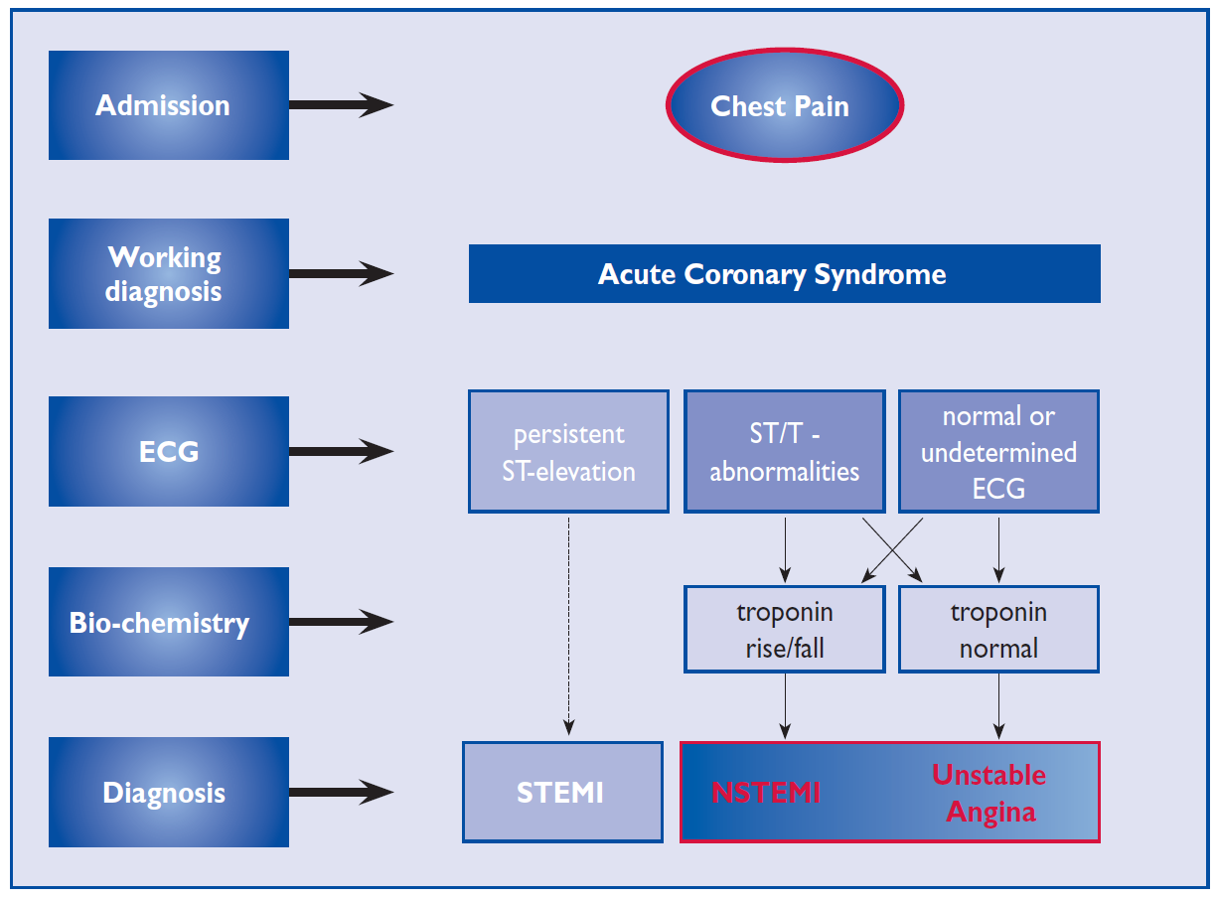
Management of Chest Pain for suspected Acute Coronary Syndromes
2014 AHA/ACC NSTE-ACS GUIDELINES

Slide 10
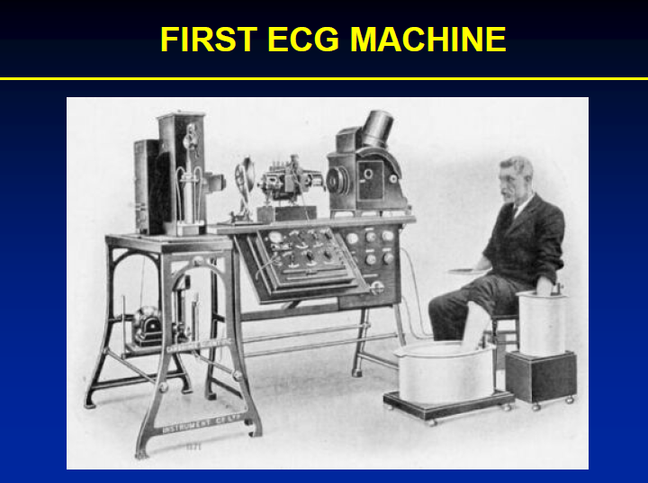
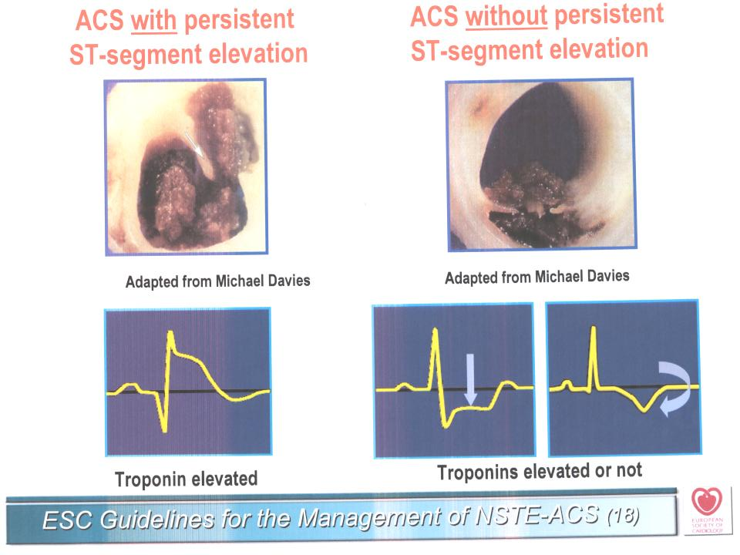
If EKG is diagnostic no problem at all…..
Unfortunatley 50% of ACS patients have normal EKG

Slide 11
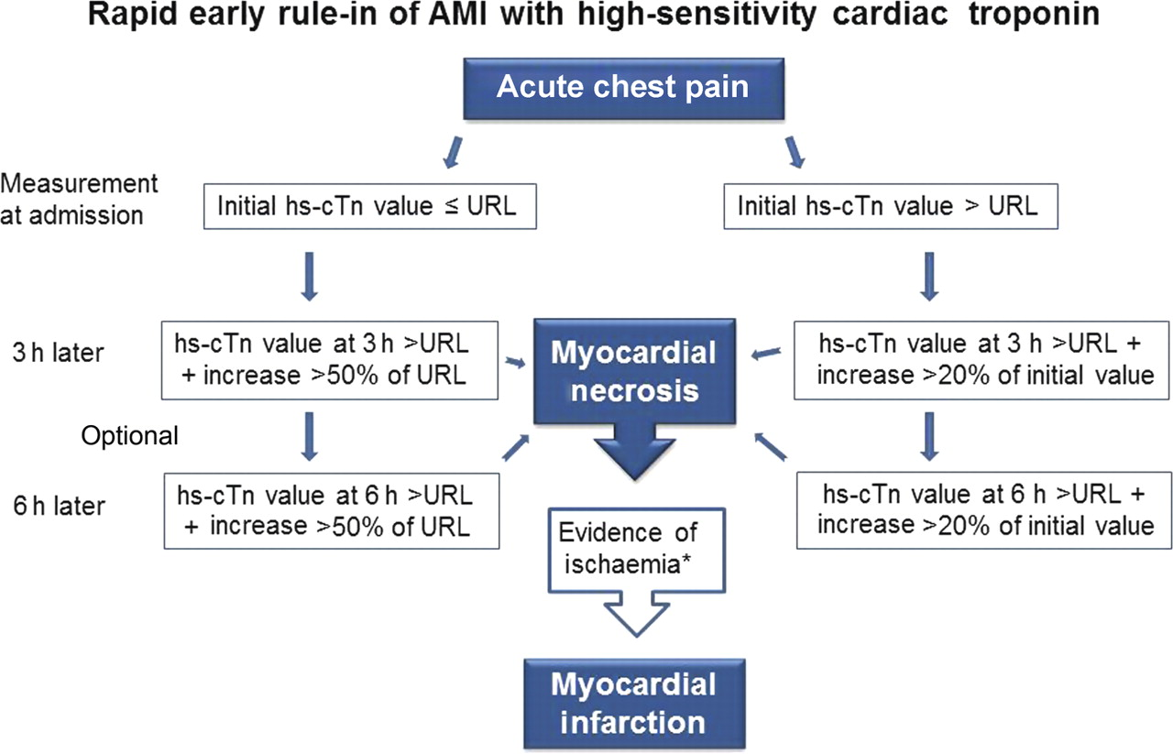
Template for rapid early rule-in of ACS with
high-sensitivity cardiac troponin.
Thygesen K et al. Eur Heart J 2012;eurheartj.ehs154
Notes:
This is a template for rapid early rule-in of acute myocardial infarction with high-sensitivity cardiac troponin this algorithm is based on current knowledge. Is the presenting value is under the 99th percentile retest troponin 3 hours later if the value is increased more then 50% rule in as MI if the increment is less than 50% you can discharge from MI otherwise if the first value is upper the 99th percentile is enough a value above 20% increase to rule in as MI
It should be noted that the stated algorithm may vary according to the troponin assay evaluated. This approach optimizes sensitivity for acute myocardial infarction diagnosis, but clinicians may also wish to choose more stringent metrics to improve specificity (see text). AMI, acute myocardial infarction; hs-cTn, high-sensitivity cardiac troponin; URL (upper reference limit), 99th percentile upper reference limit. *Evidence of ischaemia by symptoms and/or new electrocardiogram changes and/or new imaging corroboration.

Slide 12
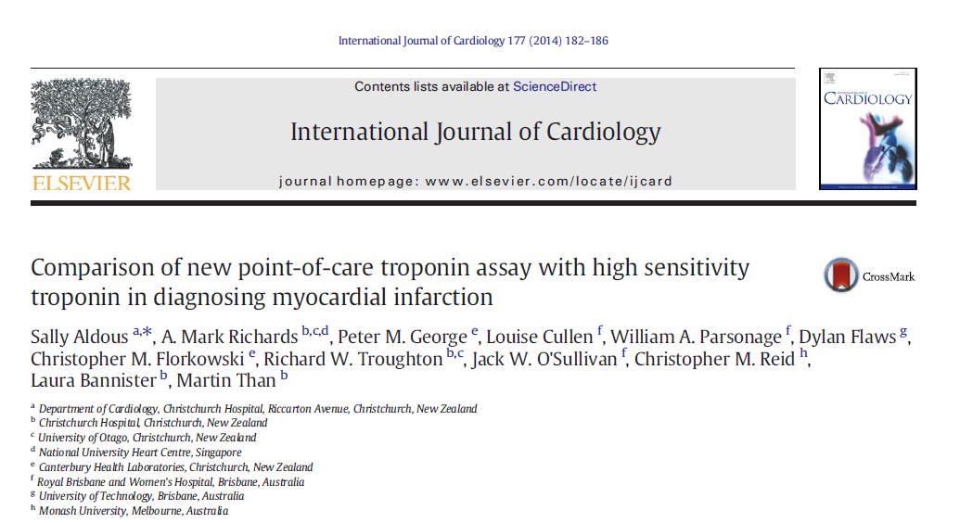
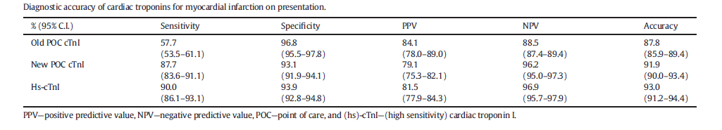

New POCT High sensitivity Troponin Assay

Slide 13
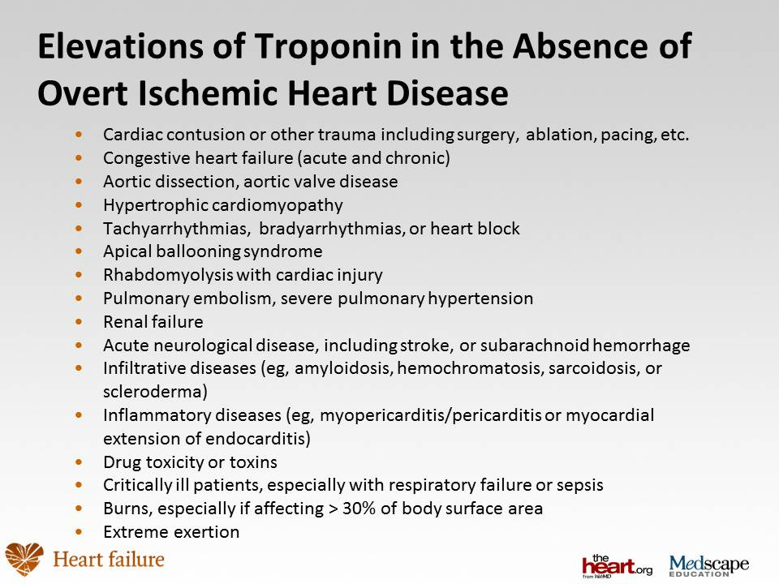
Notes:
But there are many condition different from MI in which high sensitivity troponins can rise above the 99° percentile

Slide 14

Early Risk Stratification of NSTE ACS
I
IIa
IIb
III
12-lead ECG (within 10 minutes)
Troponin
  Immediate
  Repeated if negative
Repeat ECG if negative and clinical suspicion is high for ACS
TIMI or GRACE Risk Scoring
BNP for risk assessment
Search for non-coronary causes of
symptoms
Braunwald E, et al. J Am Coll Cardiol. 2002;40:1366-74.
Notes:
The 2002 ACC/AHA guidelines strongly recommend the use of ECG and cardiac markers to quickly determine the risk status of patients presenting with suspected unstable angina.

Slide 15
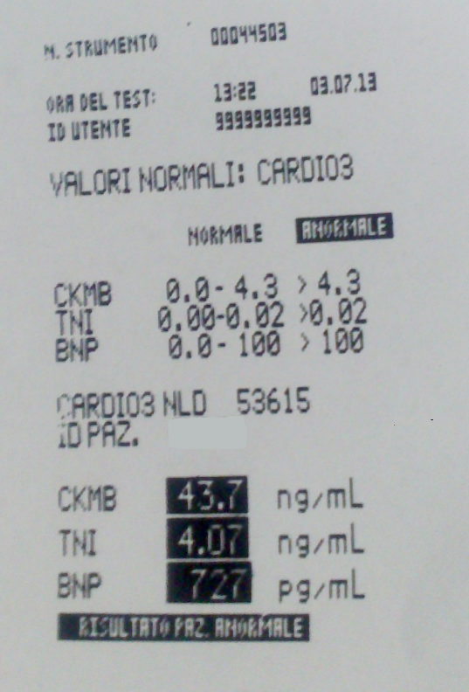
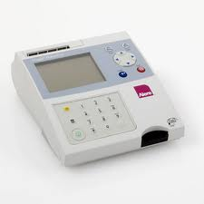
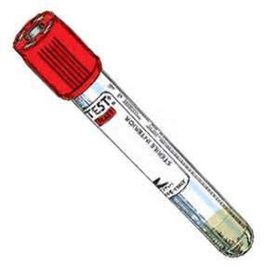
BNP for ACS diagnosis and Prognosis
Emergency Department Admission
25/09/2013 h: 12:08
TnI 4.07 ng/ml [0.00-0.03]
BNP 727 pg/ml [0.0-<100]
25/09/2013 h: 12:15
25/09/2013 h: 13:10
Tn I 8.25 ng/ml [0.00-0.06]
Tn T HS 383.5 pg/ml [0.00-13]
LAB Tests

Slide 16
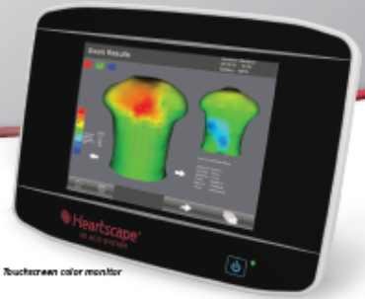
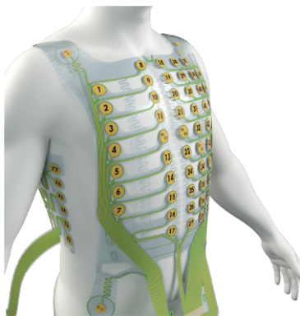
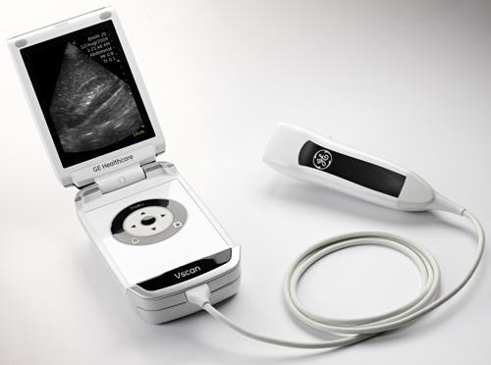
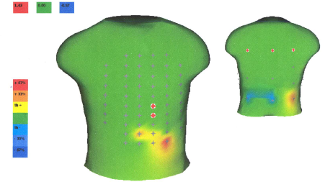
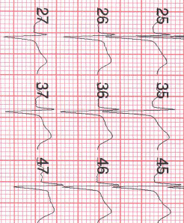
Heartscape 80 Leads ECG
Male, 52 years
Typical chest Pain with an onset of 30 minutes.
Anamnesis: MI (PTCA and stenting 2010), new PCI one year later. Hypertension. Hypercolesterolemia. Active smoker.
TIMI risk score: 4.
4 hours later:
Troponin I : 2.49 ng/ml
12 leads ECG: invariate
Echocardiogram: normal
Final diagnosis in ED: NSTEMI
Admission in CICU
ED arrival (21 Sept 2012, h 12:30) :
Troponin I: 0 ng/ml
BNP : 120 pg/ml
-12 leads ECG: SR, HR 75 bpm. Incomplete RBBB
HeartScape ECG: Red zone (ST elevation)
PCI (22 Sept 2012, h 12:00):
intrastent severe stenosis (80%) treated with POBA on distal Anterior descending artery
24 hours treatment delay!

Slide 17
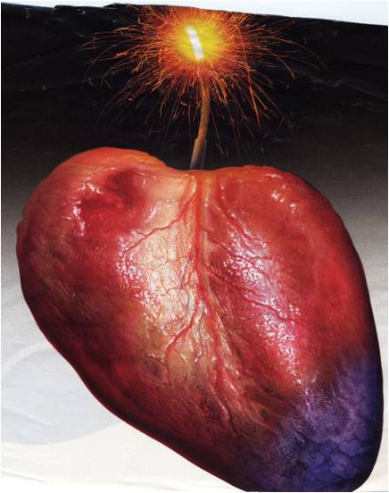
in ACS:Time is Myocardium!
We need to start the appriopriate treatment asap!

Slide 18
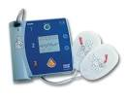
Treatment of ACS on Board
Acute myocardial infarction is certainly the most feared event among CVDs. There is a chance of sudden death and long-term disability.
The prognosis of an AMI depends on the ability to manage acute complications such as life-threatening cardiac arrhythmias and, in the long term, reducing the infarct size.
Automated External Defibrillators (AEDs) are the only possible way to save the life of a victim of ventricular fibrillation when it occurs away from advanced medical facilities. Long-term survival after AED utilization is high.

Slide 19

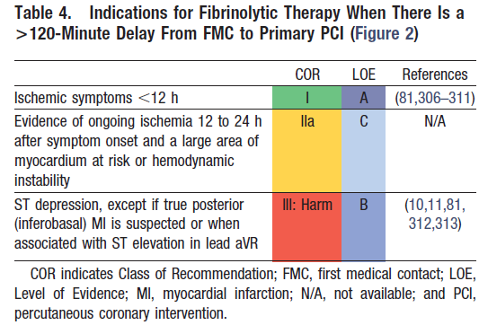
Fibrinolitic Therapy on Board
To reduce infarct size,
thrombolytic therapy is needed.
However, its efficacy is greater if applied within the first few hours of the beginning of symptoms.
2013 ACCF/AHA Guideline for the Management of ST-Elevation Myocardial Infarction.
Practice Guidelines. Journal of the American College of Cardiology Vol. 61, No. 4, 2013

Slide 20
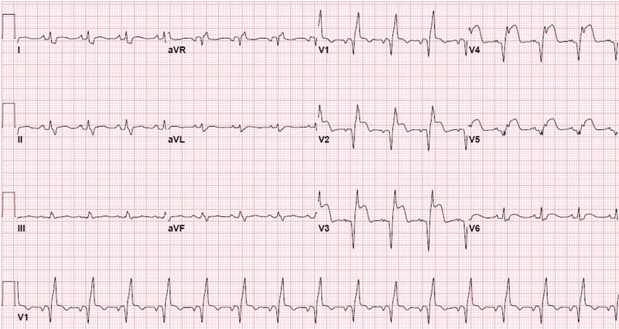
On presentation, an abnormal 12-lead electrocardiogram was present in 92% of passengers
Of the 16 passengers with acute ST-elevation myocardial infarction who received fibrinolytic therapy, 13 (81%) achieved successful reperfusion by clinical predictors and electrocardiographic criteria.
Am J Cardiol. 2010 Jan 15;105(2):153-7

Slide 21
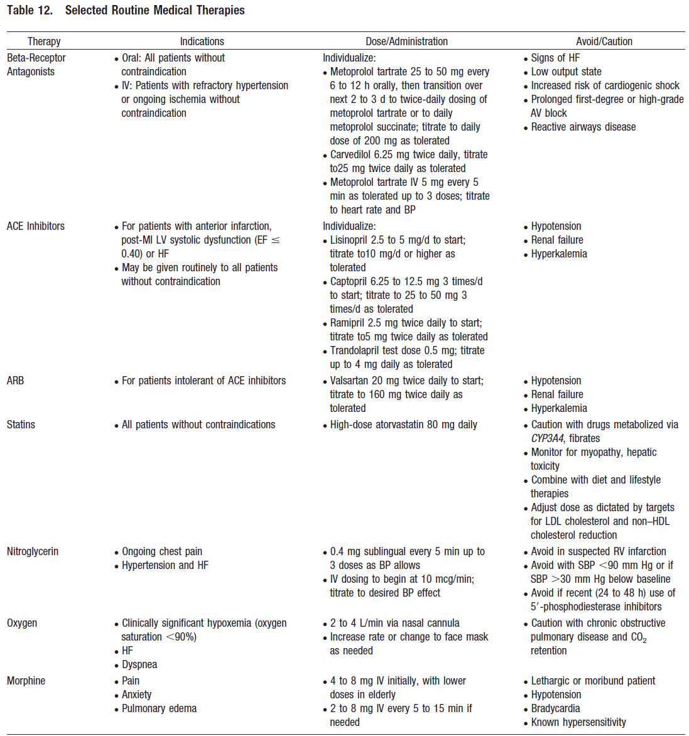

Slide 22
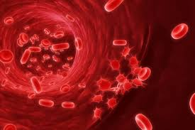
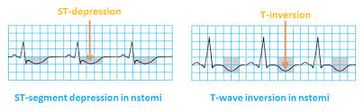
Acute Coronary syndrome Treatment on Board
Platelet activation and subsequent aggregation
play a dominant role in the propagation of
arterial thrombosis and consequently are the
key therapeutic targets in ACS.
in NSTEMI patients antiplatelet therapy should be instituted as early as possible in order to reduce the risk of :
PROGESSION OF MYOCADIUM INVOLVEMET ;
ACUTE ISCHAEMIC COMPLICATIONS ;
RECURRENT ATHEROTHROMBOTIC EVENTS.

Slide 23
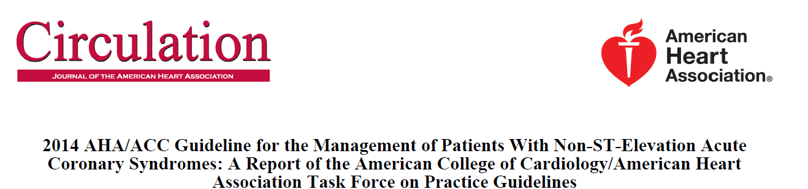
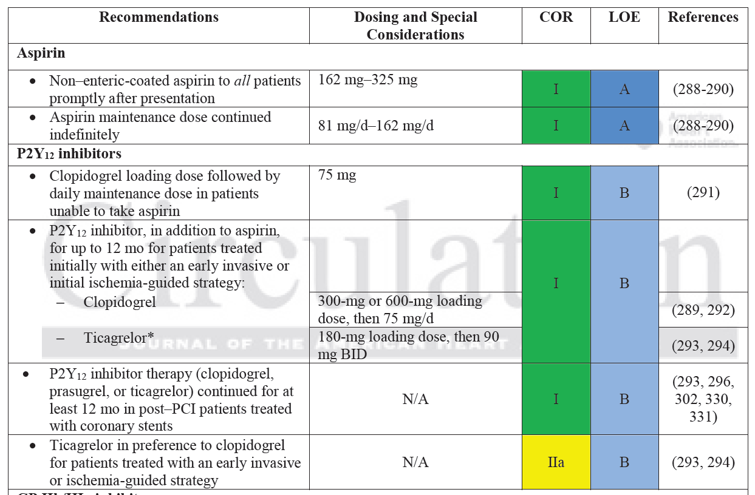

Slide 24
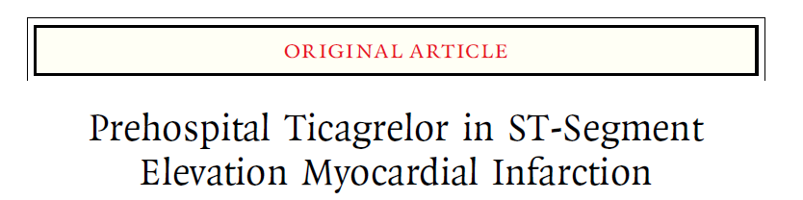
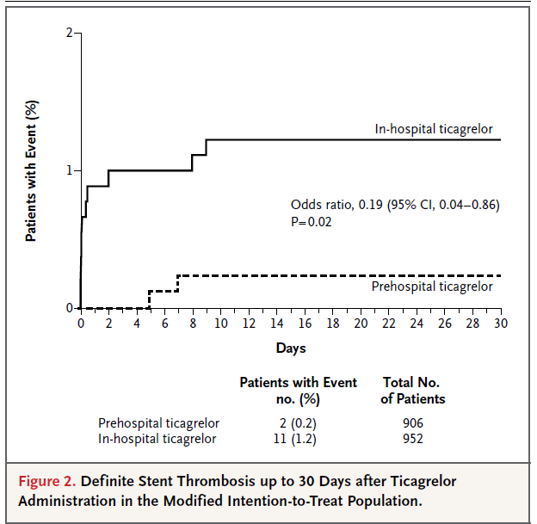


Slide 25
Most common principal CV diagnosis presenting to cruise ship infirmary
Am J Cardiol. 2010 Jan 15;105(2):153-7

Slide 26
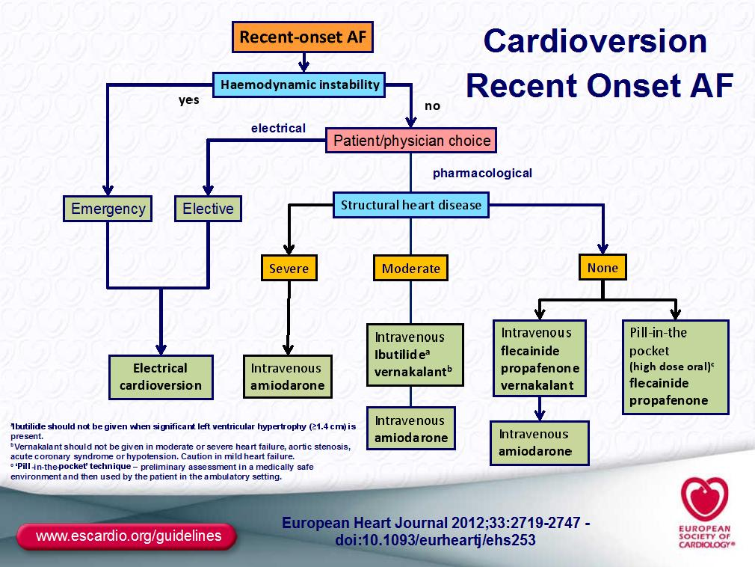

Slide 27
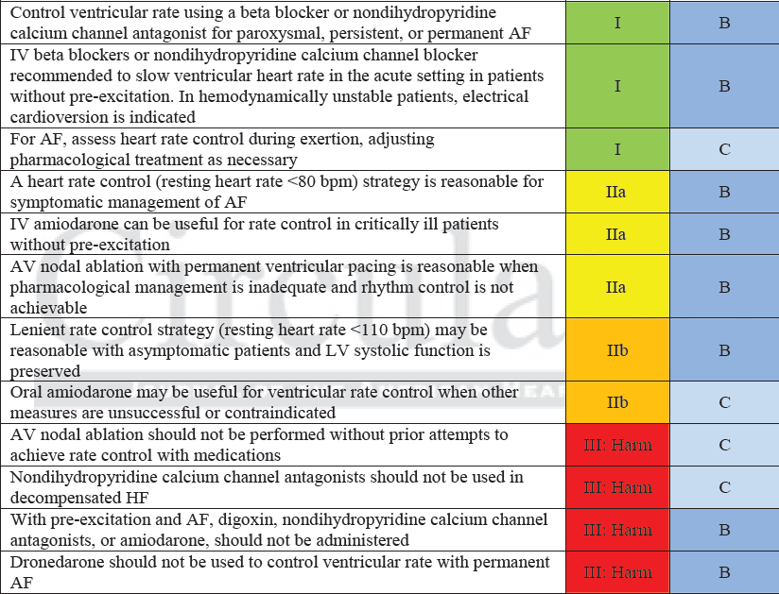
Rate Control

Slide 28


Importance of early therapies for acute heart failure
as a consequence of prompt diagnosis
In 46,599 patients with ADHF (ADHERE)
a delay in treatment was associated with:
250% ↑ in-hospital mortality
150% ↑ in-hospital length of stay
14:17-20
ADHF=acute decompensated heart failure
Peacock WF, Di Somma S et al. Congest Heart Fail 2008;14(4 Suppl 1):17–20

Slide 29

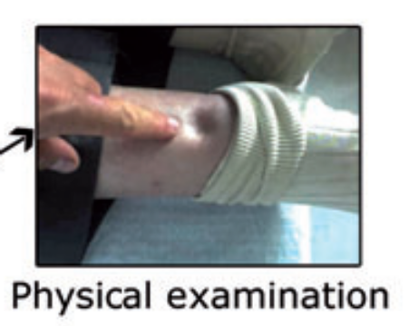
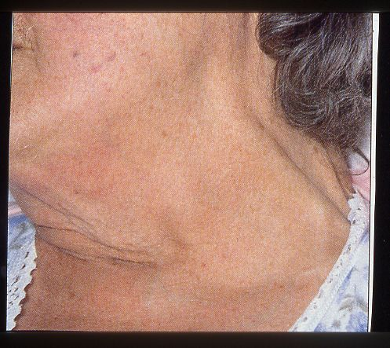
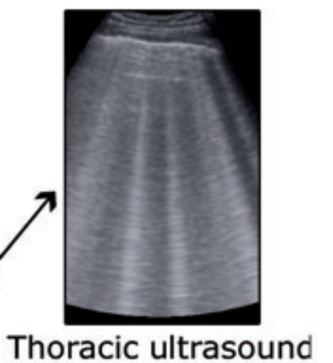
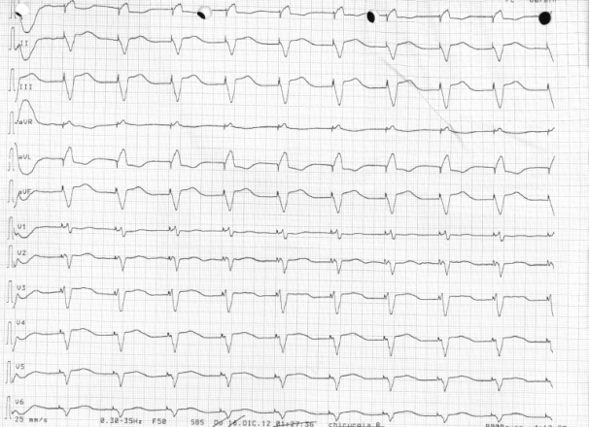
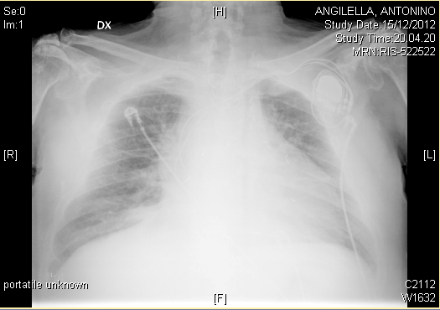
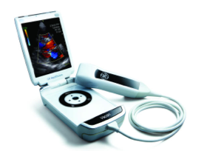
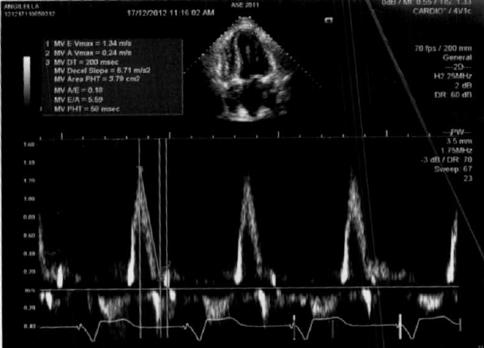
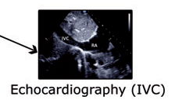
Heart Failure Diagnosis

Slide 30
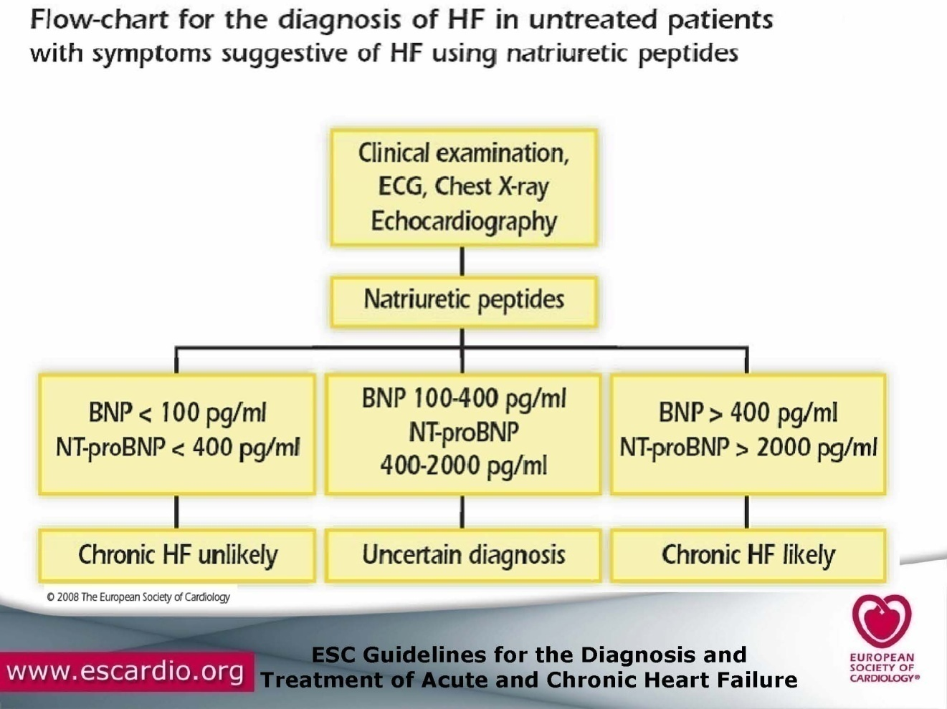
POCT BNP+HsTNI+NGAL

Slide 31

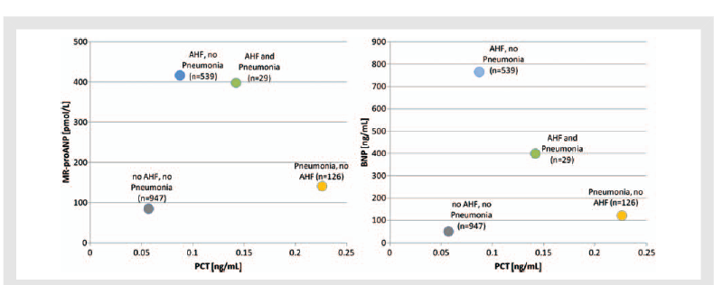
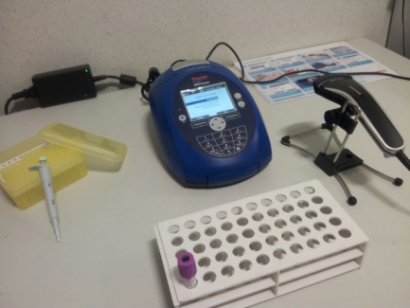
BNP +PCT for distinguishing S.O.B.
A. Maisel ,.Di Somma et al. Eur J Heart F 2012 mar;14(3)278-81

Slide 32


Caveats in using BNP

Slide 33





Slide 34

Telemecine consultancy

Slide 35






New Telemecine Device for cruising

